Slide 1
HAZARD AND DISASTER

Slide 2
HAZARD
It is a dangerous event
It may be natural or human induced
Cause injury
Loss of life, damage to property, livelihood or environment
Hazard may be natural like earthquake, tsunami, volcanic eruption etc.
Hazards like floods, landslides, drought are socio-natural hazards

Slide 3
Hazards like floods, landslides, drought are socio-natural hazards
Some of the hazards like industrial accidents, rail, road and air accidents, terrorist attacks, leakage of toxic waste, war are human- induced

Slide 4
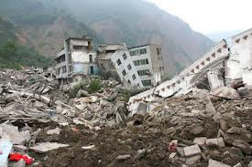
DISASTER
It results in widespread human loss
Accompanied by loss of livelihood and property
Causes suffering and loss in a definite area

Slide 5
FEATURES OF DISASTER
Disrupt in normal functioning of society
Affect large number of people
Large scale loss of life, property, livelihood
Affect the community
A big blow to the country’s economy

Slide 6
WORLD DISTRIBUTION OF DISASTER TRIGGERED BY NATURAL HAZARDS

Slide 8
WORLD DISTRIBUTION OF DISASTER TRIGGERED BY HUMAN INDUCED DISASTER

