Slide 1

Lesson 5
Surface Area
of Sphere and Hemisphere

Slide 2
Insert Lesson Title Here
6-10
Spheres
Vocabulary
sphere
hemisphere
great circle
Course 3

Slide 3
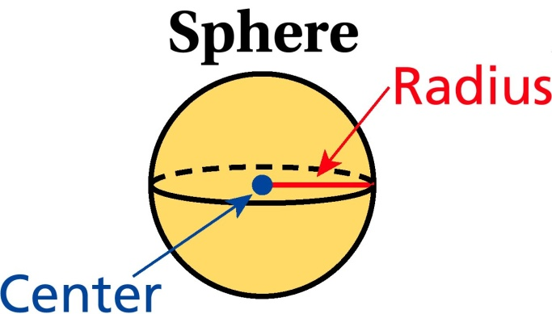
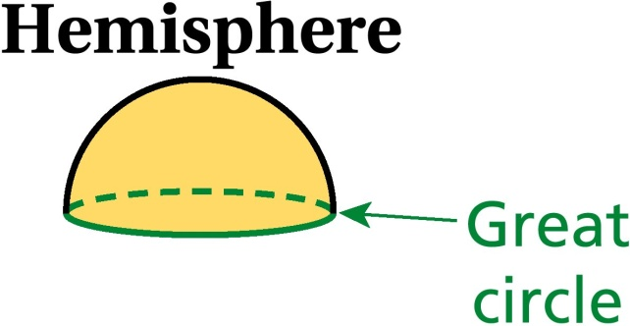
6-10
Spheres
A sphere is the set of points in three dimensions that are a fixed distance from a given point, the center. A plane that intersects a sphere through its center divides the two halves or hemispheres. The edge of a hemisphere is a great circle.
Course 3

Slide 4

it’s time for activity

Slide 5
Defination :
Sphere : The set of all the points in the space which are equidistance from a given point is called Sphere.
A Sphere has only one curved surface.
Hemisphere : If we divided a sphere into two equal parts by a plane passing through the centre, we get two hemispheres.
A hemisphere has one plane circular surface and one curved surface.

Slide 6
Formula for finding
Surface area of a sphere = 4 ∏ r²
Curved(lateral) surface area of a hemisphere = 2 ∏ r²
Total surface area of a hemisphere =3 ∏ r²

Slide 7
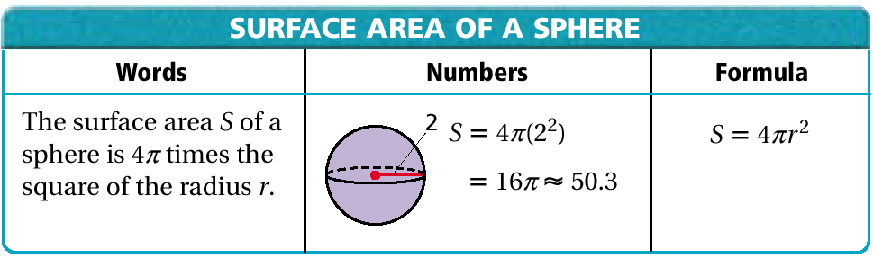
6-10
Spheres
The surface area of a sphere is four times the area of a great circle.
≈ 50.3 units²
Course 3

Slide 8
Ex-1 Fill in the blanks in each row in the following table from given table :
No. | Value of pie | Radius (r) | Diameter (d) | Total surface area of sphere | Lateral surface area of sphere | Surface area of closed hemisphere
1, | 22 7 | 5.6cm | ………… | ………… | ………… | ………..
2 | 22 7 | 10 cm | ………… | ………… | ………….. | ………..
3. | 3 .14 | ……….. | …………. | 154 cm² | ………….. | …………

Slide 9
Sol:1 .. Here, radius r = 5.6 cm
Diameter d = 11.2 cm
Total surface a area
of a sphere = 4 ∏ r²
= 4 X 22/7 X (5.6) ²
= 394.24 cm²
lateral surface area
of a hemisphere = 2 ∏ r²
= 2 X 22/7 X (5.6 ) ²
= 197.12 cm²
Total surface area of a hemisphere = 3 ∏ r²
= 295.68 cm²

Slide 10
Ex-2.The radius of a spherical balloon increases as air is pumped into it. Find the ratio of surface area of the balloon in this two situations.
Soln: (1) Radius of the balloon r = 14 cm
Surface area spherical balloon = 4 ∏ r²
= 4 x ∏ x 14 x 14 cm²
Soln: (2) Radius of the balloon r= 21cm
Surface area spherical balloon = 4∏ r²
= 4 x ∏ x 21 x 21 cm²
Ratio of the surface area s in these two cases
= 4 x ∏ x 14 x 14 cm² = 4 =4:9
4 x ∏ x 21 x 21 cm² ⁹
Thus required ratio is 4:9

Slide 11

Ex-3 The Internal and external radii of a hallow hemi-spherical vessel are 15 cm and 16 cm respectively. The cost of painting one cm² of the surface is Rs 7. Find the total cost of painting the vessel all over.
Sol: For the internal hemisphere ,
Radius r₁ =15 cm
Lateral surface area of a hemisphere = 4∏r₁²
= 2 x 22 / 7 x 15 x 15
= 9900 / 7 cm²
For the external hemisphere, Radius r₂=16 cm
Lateral surface of a hemisphere = 2 ∏ r₂²
= 2 x 22 / 7 x 16 x 16
=11264 / 7cm²
total area to be painted = 9900/7 + 11264/7 = 21164/7 cm²
Cost of painting 1 cm² Rs 7
Cost of painting 21164/7 x 7 = Rs 21164

Slide 12
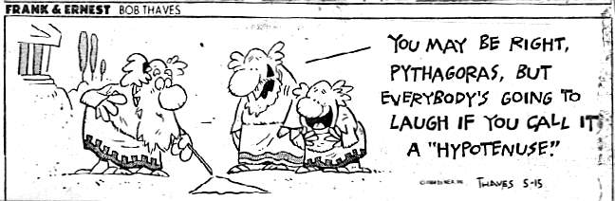
Homework Time!

Slide 13
EXERCISE 15 . 4
QUESTIONS ARE 4 , 5 AND ALL ILLUSTRATION

Slide 14


