Slide 1

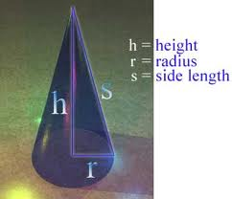
LESSON 4
SURFACE AREA OF CONE
FROM SUNITA JAT

Slide 2


Slide 3
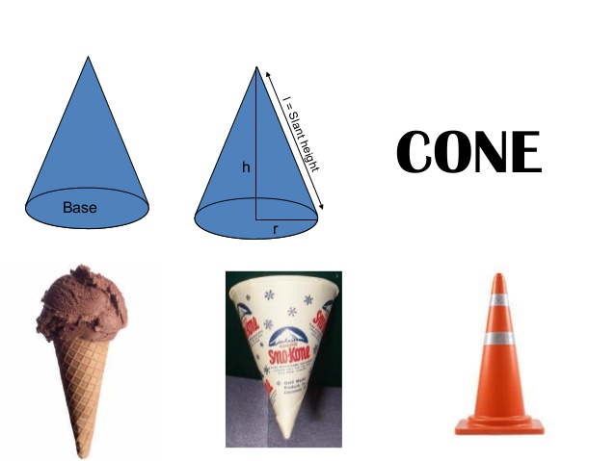

Slide 4
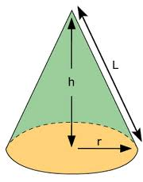

Slide 5
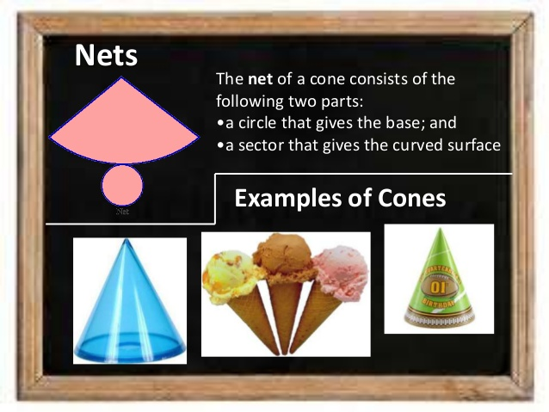

Slide 6
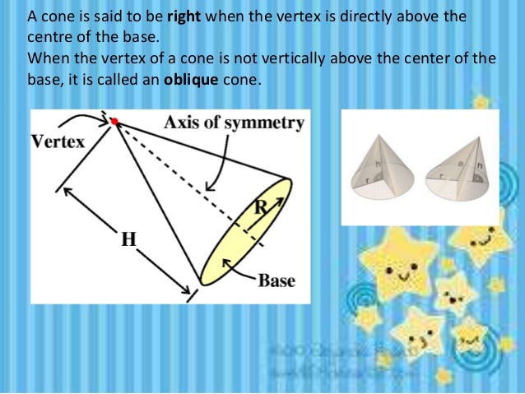

Slide 7
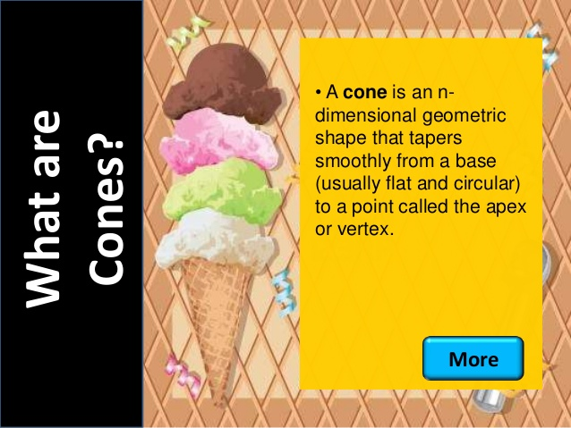
Actually what is cone ?
A cone is generated by the rotation of a right angled triangle about one of its sides forming the right angle.
This cone is called a right circular base and a curved surface.

Slide 8
Formulae:
For a cone, radius is represented by r, the height (vertical height) is denoted by h and the slant height is denoted by l.
l ² = r² + h²
Curved (lateral ) surface area of cone = πrl
Total surface area of a cone = πr² + πrl
Or πr(l + r)

Slide 9
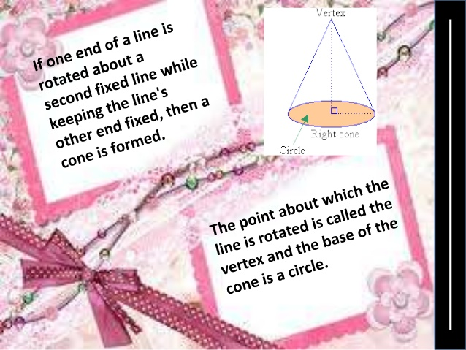

Slide 10

Surface Area of a Cone
Find the area of a cone with a radius r=3 m and height h=4 m.
r = the radius h = the height l = the slant height
Use the Pythagorean Theorem to find l
l ² = r² + h²
l ²= (3)² + (4)²
l ²= 25
l = 5
Surface Area of a Cone
= πr² + πrl
= 3.14(3)² + 3.14(3)(5)
= 75.36 m²

Slide 11
Ex 2. A conical tent is 12 m and high and the radius of its base is 5 m.
Sol: 1) The slant height, for conical tent
radius r =5 cm and height h= 12 m
l² = r² + h²
= 5² + 12²
=25 +144
=169
l = √ 169 =13 m
Thus ,the slant height of the conical tent is 13 m.

Slide 12
2)The cost of the canvas required to make ,If the cost of canvas is Rs100
Lateral surface area of a conical tent
=∏ r l
=3.14 x 5 x 13
=204.1 m²
Thus 204.1 m² cloth is required to make the tent.
Cost of 1² canvas =100 Rs
Therefore,
Cost of 204.1 m² canvas = Rs(100x204.1)
=Rs 20,410

Slide 13
Ex3. A joker’s cap is in the form of a right circular cone of base radius 7 cm and height 24 cm. Find the area of the sheet of paper required to make 15 such caps
Sol: For the conical, r=7 cm and h =24 cm
l² = r² + h²
= 7² + 24²
= 49 +576
=625
Therefore, l = 25.
Now, Curved surface area of a cone = ∏ r l
= 22 x 7 x 25
7
= 550 cm²
Thus 550 cm² paper is required to make one cap.
Then, the area of paper sheet required to make 15cm
=15 x550=8250 cm²

Slide 14
Ex5. How many conical tents, each of height 4 m and radius of base 3m, can be prepared from cloth 280.60 m² .
Sol: For a conical tent. radius r= 3 m and height h= 4m
l² = r² + h²
= 3² + 4²
= 9 + 16
= 25
l = 5m
Curved surface area of a conical tent = ∏ r l = 3.14 x 3 x 5 = 47.1 m²
Number of tents prepared from 47.1 m² cloth=1
Number of tents prepared from 282.60 m² cloth
= 282.60
47.1
= 6
Thus,6 tents of given cloth can be prepared.

Slide 15
It’s time for H.W
Exersice 15.3
Ques 1,4
All illustration examples

Slide 16


